Slide 1
River Hawk Risker
An Abnormal Transaction Alert AI System
Erdun E & Zijun He

Slide 2
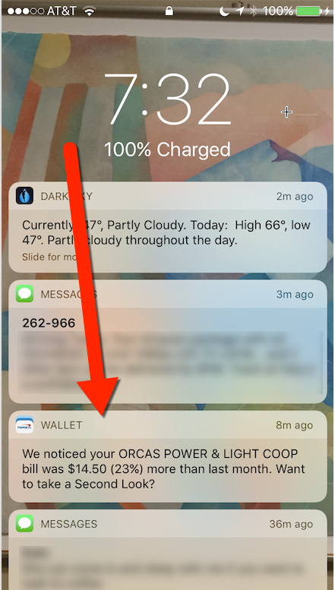
To prevent
● fraud transactions
● identity theft on the card
● Money laundering
● …

Slide 3
Why we do …
● Cheaper
● Relevant to everyone
● …

Slide 4
Preprocessing Data
Many records
sample imbalance
some transactions have no labels
too many features

Slide 5
Models
Random forest, Ada Boost, and Gradient Boosting Decision Tree, DNN independently
Combine GBDT and DNN

Slide 6
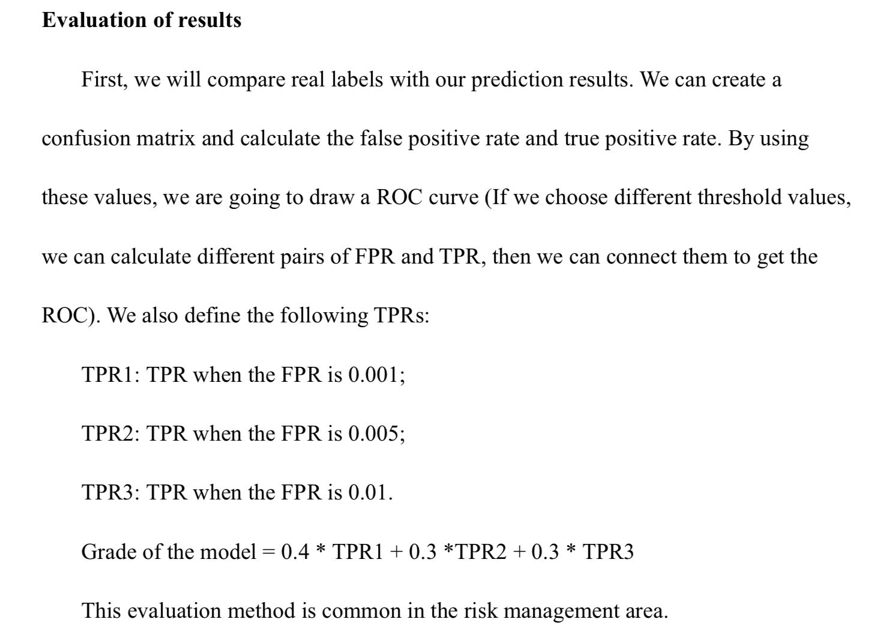
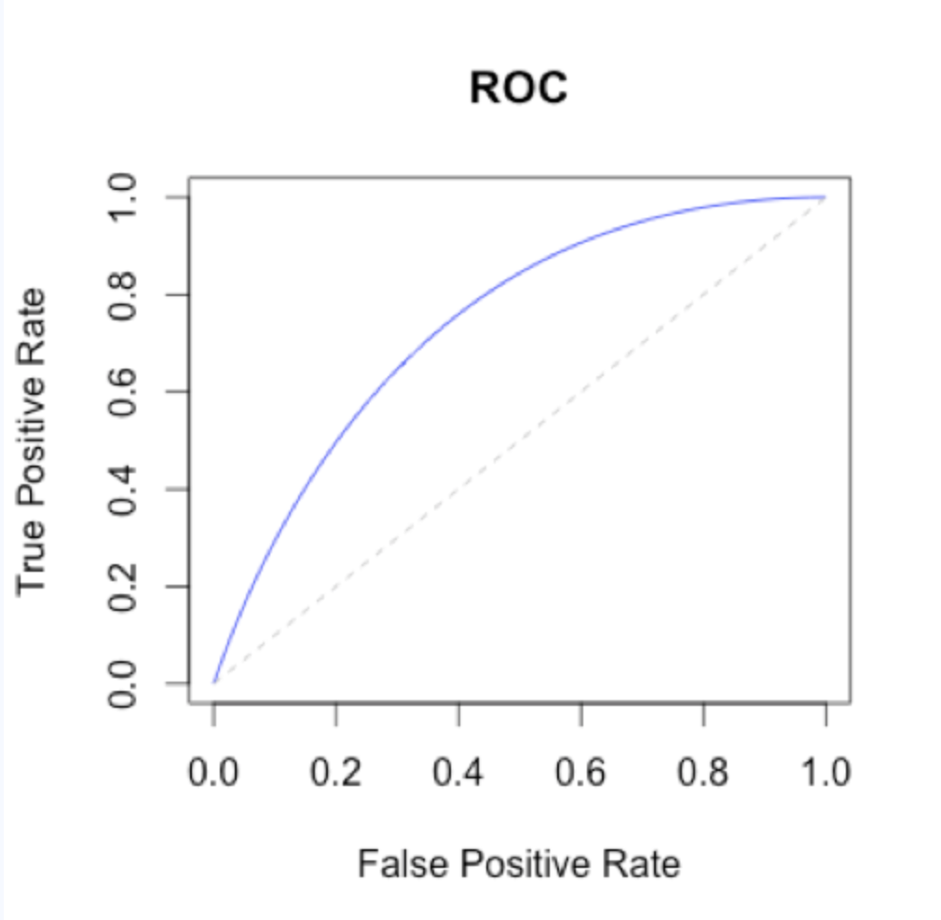
Evaluation of the Model

Slide 7

Thank you for listening

